Slide 1


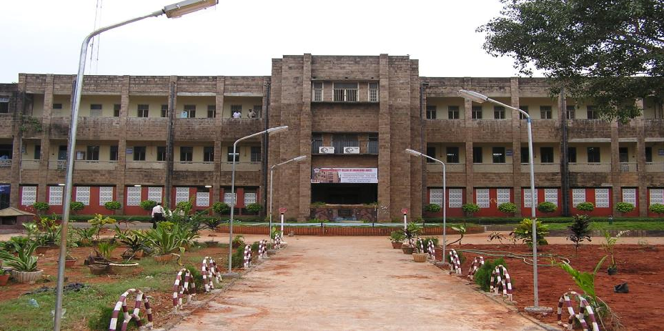
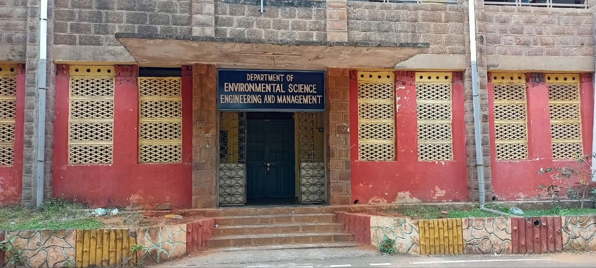
HEARTY WELCOME
Hon’ble Chairperson and Members of NAAC Peer Team
Department of Environmental Science, Engineering and Management A U College of Engineering
Andhra University, Visakhapatnam
5th November, 2023

Slide 2

OVERVIEW
Vision & Mission of the Department
Department Profile/History/Achievement
Curricular Aspects
Teaching & learning
Research , Consultancy and Extensions
Students Support and Progression
Infrastructure and Learning Resources
Best Practices
Progressive Plan

Slide 3


Vision
Excellence
Develop as a reference and resource hub integrating knowledge and expertise in the specialty of environmental engineering, management and sustainable development
Develop as a nodal agency for the development of environmental entrepreneurship and skill development
Focus on environmental interventions and innovations useful to the society
Contribute to the transformation of technology to the field for the betterment of the society through training, research and development and community/society development activities

Slide 4
Mission
Department acts as an environmental think tank for the state of Andhra Pradesh and neighboring states and other Indian states of India.
Provide excellent education in the field of environmental sciences and engineering, conduct basic and applied research, addressing management of natural resource, environmental challenges of humanity and industry in assisting the governments in policy development and governance.
Promotion of interdisciplinary innovative research and dissemination of knowledge for the transformation of lives and livelihoods towards sustainable development.
Support the government in its efforts in environmental management, addressing climate change challenges and sustainable development through apposite research.
Promoting partnership with various stakeholders’ like students, institutions, industry, governments, business organizations, Non-government Organizations, and local communities .
Department of Environmental Science,Engineering & Management

Slide 5


Programme Educational Objectives (PEOs) – UG B.Tech. Programme
Programme Educational Objectives are long term statements to educate the students about objectives of Mechanical Engineering Programme
Keywords
PEO1:
Educate the students for successful careers in Environmental Engineering field that meets the needs of National and International organizations.
Successful Careers
PEO2:
Impart the knowledge in mathematical, scientific and engineering fundamentals to identify, formulate and design engineered solutions to environmental issues and challenges in air, water, land and bio environment.
Knowledge Impart
Solutions to Environmental Issues
PEO3:
Provide basic principles of environment, concepts of environmental protection, and their significance in the socio-economic development
Principles of Environment
Socio-economic development
PEO4:
Apply various aspects of sustainable development elements in the design and development of best management practices for environmental management
Sustainable Development
Management Practices
PEO5:
Engross in life long process of learning to keep themselves abreast of current developments in the field of environmental engineering and management and promote skills to work in collaboration with others.
Process of Learning and Promote Skills
Work in teams

Slide 6






Department profile
Department of Environmental Science, Engineering & Management
Started as Centre (CESCC) on 5th June 2020
Started B.Tech (Environmental Engineering) in 2021
Department was inaugurated on 22nd April, 2022
2023
Inaugurated the Department of Environmental Science, Engineering & Management
Started B.Tech (Civil Environmental Engineering) India’s first UG Program in Environmental Engineering
2022
2021
Started B.Tech. in Environmental Engineering & Ph.D. in Environmental Science, Engineering & Management
1980
2021- UG course in DESEM : Intake: 30
Department of Environmental Science, Engineering & Management
7

Slide 7

















































NBA
MoUs (1)
Networking and Collaborations (1)
NAAC
Department Achievements
CoEs (2)
Quality
“The reputation of the Department is decided by its Faculty and students' and quality of research”
Infrastructure
Faculty
Awards (15%) Best Teacher
Department Started in 2021
Faculty Achievements
BOS/EC/AS/ PhD-DRC (5)
Internships for 20 students
Publications (380) , Patents published (01) & Books/Chapters ( 10)
TOC
E FRM DC Air Sampler (purchase order was placed)
Ph.D. Guidance (18) and R&D Projects (4.85 Cr), Consultancy projects ( 1.77 Cr)
AERMOD Software ALOHA,
FDPs / Workshops/expert talks (120)
Admissions (67%) and Quality of
Input (84%)
Good SFR and Faculty Qualifications (< 1:20, 15 PhDs, 3 Pursuing)

Slide 8
Infrastructural Highlights
Department
Ergonomically Designed Infrastructure
Library
Equipment
 | Wet lab Equipment
Aesthetically well planned
Class Rooms: 6
Digital Library through A U library net
Books, Journals and magazines
E books
Ergonomically Designed
Laboratories: 1
Total Organic Carbon
E FRM-DC (Purchase order was placed)
Eco- friendly class rooms & labortories
Staff rooms: 3
Office Rooms: 1
Department of Environmental Science, Engineering & Management

Slide 9
Feathers in The Cap : DESEM, AUCE
Department of Environmental Science, Engineering & Management
R & D and Consultancy Funding
(Rs. 5.39 Crores)
Environmental Engineering Research Lab
Experienced Faculty
SA CC Studies under NCAP
Feasibility of the conveyor belt for the bulk Cargo handling at the Gangavaram port
Technical Proposal on Climate-Smart Integrated Water Resources Management in Vishakhapatnam in relation to Visakhapatnam Industrial corridor
Department of Environmental Science, Engineering & Management

Slide 10
Department Profile & Milestone
Programs | Sanctioned Intake 2021-22 | Students Strength 2021-23 | Faculty Strength in 2021-23
B.Tech. Environmental Engineering | 30 | 40 | 5 (Two regular and one Honorary and two Emeritus Professors)
PhD in Environmental Science, Engineering and Management | - | 1
Profile
AU Started B.Tech. in Civil Environmental Engineering (first in India)
Started Ph.D. in Environmental Science, Engineering & Management
1980
2021
2021
2022
Started B.Tech. in Environmental Engineering
Inaugurated Department of Environmental Science, Engineering and Management (DESEM) as a constituent department of the A.U. College of Engineering
Department of Environmental Science, Engineering & Management

Slide 11






Leadership
Education
Experience
Professional Experience
Funded Projects / Books
B.E., in Civil Engg
  JNTU
M.E., in PH & EE
  AU
PhD
  IIT Roorkee
Teaching
  29 years
Research
  22 years
  Industry
  16 year
.
HoD, Professor
Director, CISC, AU
Expert Member on several committees of government of AP and India
Invited Speaker
Subject Expert
Reviewer, Chairperson
More than 600 Lakhs 450 Lakh (PI)
ASCE Book Chapter
Prof. S. Bala Prasad
HoD, Dept. of Environmental Science, Engg and Management.
Research Contributions
FDPs/Talks/ Conferences
Projects Guided/Pursue
Awards
Produced PhDs
Published 25
Guiding 3 Scholars
Organized
  3 International Conferences
Attended
  5 FDPs
  25 Conf
15 + Tech Talks
Guided
UG – 100+
PG – 65+
Ph.D – 2
FIRST RANK in M.E.
Public Health and Environmental Engineering -1992 Andhra University
Guiding
PG – 06
Ph.D – 3
Department of Environmental Science, Engineering & Management

Slide 12

Teacher’s Profiles
Criterion 2
S. No. | Name | Designation | Qualification | Specialization
1 | Prof. S. Bala Prasad | Professor Head of the Department | M.E. (PH &EE) Ph.D. | Environmental Engineering and Management
2 | Prof. Yerramsetty Abbulu | Professor BOS, Chairman | Ph.D. | Water Resources Engineering Hydraulics Coastal and Harbour Engineering
3 | Prof. C V Chalapati Rao | Emeritus Professor Former Senior Most Chief Scientist, NEERI, Nagpur | Ph.D. | Environmental Engineering and Management
4 | Prof. V.S.R.K. Prasad | Emeritus Professor, Former Director IIPE, Vizag | Ph.D. | Chemical and Environmental Engineering and Management
5 | Prof. Prakasam Tata | Visiting Professor Former Head, Environmental Monitoring and Research Division, Metropolitan Water Reclamation District of Greater Chicago, USA | Ph.D. | Environmental Engineering and Management
Department of Environmental Science, Engineering & Management

Slide 13
Faculty
Designation
Qualifications
Average Experience: 30 years
Faculty Information
Professors
Average SFR:
3
Visiting & Emeritus Professors
5
Doctorates
15:1
2
Current SFR:
94%
8:1
Retention Rate:
Former Director, IIPE, Visakhapatnam, Govt. of India
Former Chairman, SEAC, MoEF &CC, Govt. of India
Former Senior Most Chief Scientist, NEERI, Nagpur
Former Research Division, Metropolitan Water Reclamation District, Chicago, USA
Honorary Director, CISC, A.U
Ex Independent Director, Greater Visakhapatnam Smart city Corporation Limited
Ex Chairman, Finance Committee, Greater Visakhapatnam Smart city Corporation Limited
100%
Administrative Positions
VCs, 5
Department of Environmental Science, Engineering & Management

Slide 15

Research and Consultancy / Extensions
Criterion 3
S. No. | Agency | Fund received (In Lakhs) | Duration
1 | APEPDCL, Visakhapatnam (Power for All, World Bank Project) APSPDCL, Tirupati (Power for All, World Bank Project) | ₹21.75 ₹ 44.14 | 2019-20
2 | NCAP through APPCB / CPCB | ₹ 330.04 | 2021-22
3 | Water Resources Department, Govt. of Andhra Pradesh | ₹ 76 | 2021-22
4 | SEEEC Consultants Hyderabad. (for Gangavaram Port Private Ltd) | ₹ 8.24 | 2022-23
5 | Mott MacDonald Private Limited (UK) VCICDP-PMSC | ₹13.45 | 2023-24
6 | NCAP through APPCB / CPCB | ₹ 141.60 | 2023-24
Department of Environmental Science, Engineering & Management

Slide 16
Research and Consultancy/Extensions
Department of Environmental Science, Engineering & Management

Slide 17

Academics Highlights
Faculty average age - 48 years
Faculty avg. experience – 25 yrs
Maximum experience : 50 yrs
Number of labs per department: 1
Total cost of Equipment: Rs. 55 Lakhs
Qualified, Experienced and Motivated Faculty
Well Equipped Laboratories
Academics
Workshops and courses for excellent SKA development
Students Results
Consistent results : 75%
Value Added Courses
Internships
Industry institute interaction
Model Development in the lab
Department of Environmental Science, Engineering & Management

Slide 18

















Initiatives of DESEM:
Partnerships – I-I-I
Thrust Areas of Research
Dispersion Studies
Joint collaborative projects (05)
Internships (20)
Carrying Capacity Studies
Air Pollution
Industry Institute Relations
Thrust Areas of Research
Expert lectures (08)
seminars (04) and
Industry
visits (01)
Solid Waste Management
Environmental Impact Assessment
Water & Wastewater Management
Department of Environmental Science, Engineering & Management

Slide 19









Thrust Areas
Air Pollution Control Studies
Carrying Capacity Studies
Source Apportionment Studies
Emission Inventory
Dispersion Model
Air Pollution
Eco System Health
Water Resources
Climate and Weather Patterns
Social and Economic Aspects
Carrying Capacity Studies
Water Conservation and Efficiency
Sustainable Water Supply
Wastewater Treatment
Ecosystem Protection
Water & Wastewater Management
Emission Sources
Metrological Conditions
Pollutant Types
Stack Parameters
Modelling Tools
Dispersion Studies
Waste Reduction
Waste Segregation
Composting
Landfill Management
Solid Waste Management
Environmental Management Plan
Monitoring and Enforcement
Health Impacts
Social and Cultural Aspects
EIA
Department of Environmental Science, Engineering & Management

Slide 20






Major / Key Initiatives
Faculty Centric
Incentive for Grants received
Financial Assistance for attending Workshop/Seminars/Conferences
Monetary incentives
Free Medical Facility
Staff
Centric
Student Centric
- Add-on courses and work in the industries during week ends
Minors & Honorary Degrees
Free Medical facility
Remedial Classes
- Skill Enhancement Training
Free Medical Facility & Insurance
Encourage to acquire knowledge in new and emerging areas
Department of Environmental Science, Engineering & Management

Slide 21






















Faculty Centric Policies & Utilization
Pursue Higher Studies (100%, 1) , Corporate Training (2) & Research Work with on-duty leave (1)
Writing Research Proposals
Take up Consultancy with incentives
Membership in Professional bodies(2)
Publishing Papers
Medical Bills
Reimbursement
Filing Patents (1)
Attending/organizing workshops, FDPs, STTPs, Seminars, and Conferences
Faculty Centric Policies & Utilization
Encouragement
Financial
Assistance
Tuition fee and Transport fee for the children of our staff (25%)
Fee Concession
Subsidized transport facility (100%)
Gratuity(100%)
Group Insurance(100%)
PF
Loan – Society (100%)
Accidental Insurance
Hostel stay
ESI
Facilities
Maternity leave (100%,)
Paternity leave (100%)
Study Leave (100%)
CL, EL, PL (100%)
Medical leave (100%)
Leave Provision
Department of Environmental Science, Engineering & Management

Slide 22











01
02
03
04
05
Student Centric Policies & Utilization
Recognition
Financial
Assistance
Industrial trips (4)
Sports & Cultural Activities (1)
Merit Scholarships
Publishing research papers
Innovative Projects
Facilities
Digital Initiatives
Training & Counseling
Career Guidance
Training &
Placement
Self-Study Component
NPTEL and MOOCs
Internships (100%)
Membership in Professional Societies
R&D Centre – Reseach Culture (485 Lakhs)
MoUs with R & D
Web based Students’ Management System (ERP)
Course Registration
Attendance & Marks Entry
OBE Analysis, Examination Automation Process
Announcement of Results in time
Progress Reports
Feedback and Faculty Appraisal
and Industries
CoEs:Skill Lab&NT •
Grievance Cell
NSS & NCC
a-Hub
Department of Environmental Science, Engineering & Management

Slide 23
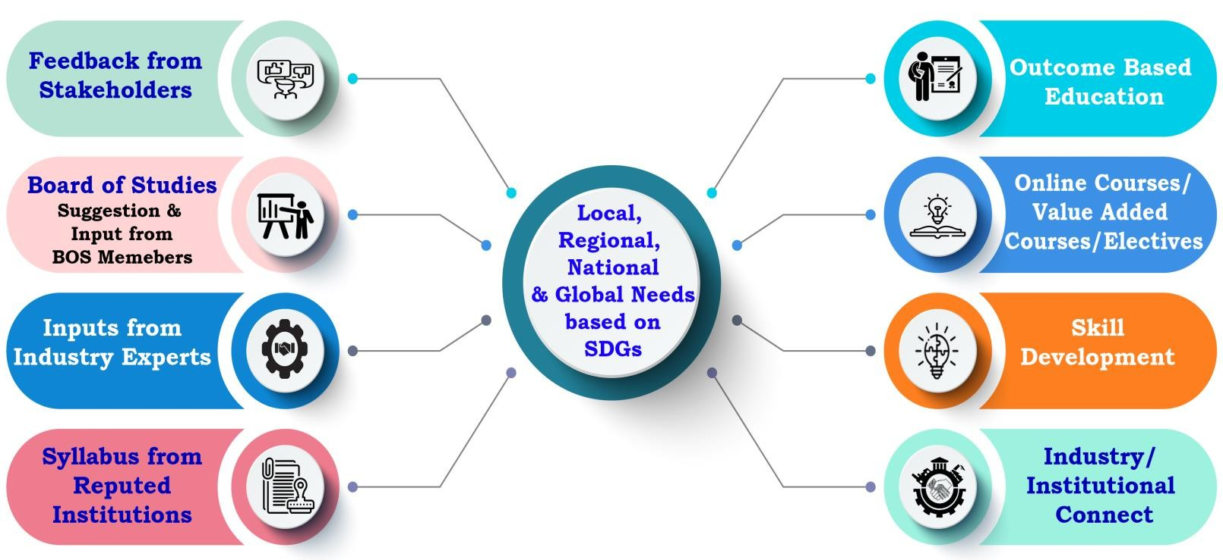
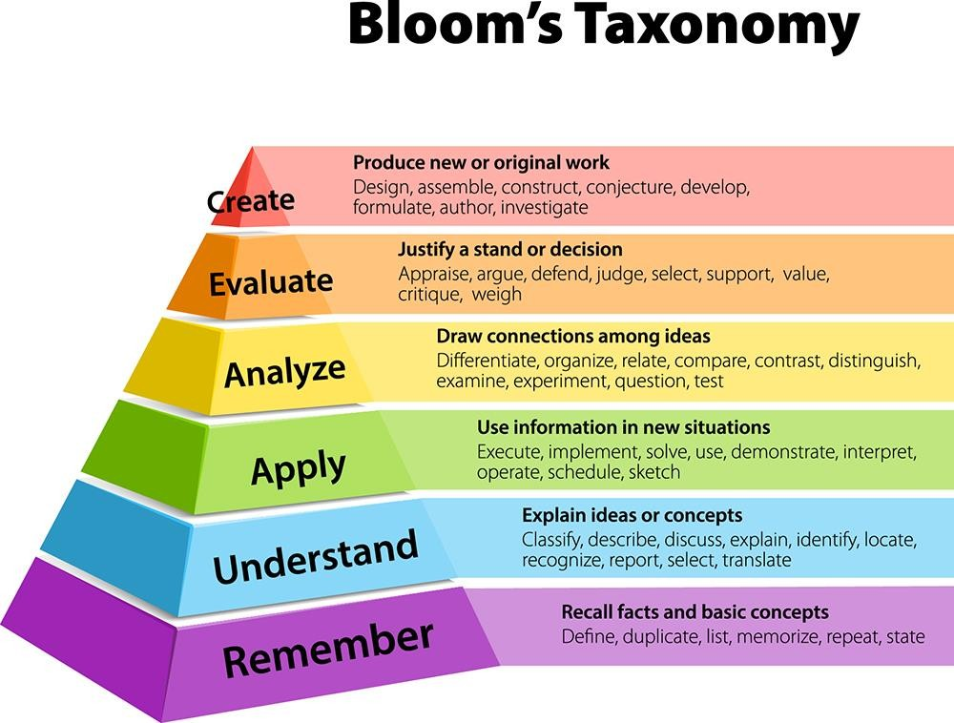
CURRICULAR ASPECTS: CURRICULUM DESIGN & DEVELOPMENT PROCESS
AICTE Model Curriculum
UGC
NEP 2020
Bloom’s Taxonomy
APSCHE
Andhra University
Approved by,
Academic Council & Executive Council
NEP in Curriculum
Multidisciplinary/interdisciplinary- Minor Degrees, Honors Degrees with Specialization
Academic bank of credits (ABC)
Skill development: Skill Labs, Dassaults Laboratory, CoEs
Appropriate integration of Indian Knowledge system (teaching in Indian Language,
culture, using online courses)
Focus on Outcome based education (OBE)
Online education: Online Platforms, E-Content , LMS, etc.
Department of Environmental Science, Engineering & Management

Slide 24
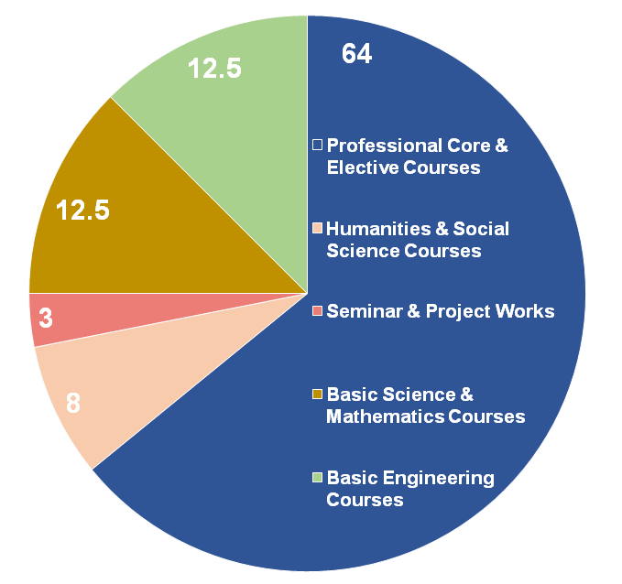
BOS of AU-MED will prepare the Curriculum Schemes
by referring to
  AICTE/UGC/APSCHE/AU/CBCS/NEP Guidelines
  Professional body Guidelines such as CMSI/SAE
  Current requirements of the Industry
  Stake Holders’ Inputs
Revision of the Curriculum
  Industry/Market Requirements
  Feedback from Stakeholders
  Once in Six Months
  Minor Changes In Curriculum
  Introduction of New Electives
Academic Flexibility
  Choice Based Credit System
1. Curricular Aspects
Curriculum Design
  2021-22 Batch – 30
  Courses offered with 1/2/3/4 credits
  Additional credits can be earned from add- on courses
  Provision for transfer of credits when the students migrate
Minors
Vertical mobility within the programmes
2022-23 Scheme | Course Components
NEP Compliance
Ability Enhancement Courses
Engineering Science Courses
Programming Language Courses
Emerging Technology Courses
Integrated Courses, Horizontal
Mobility
- 160 credits, Trans-, Inter-, Intra-, Cross-
and Multidisciplinary
Department of Environmental Science, Engineering & Management

Slide 25

Criterion 1
Courses with employability/Skill development/value added programmes offered in U.G
Average percentage of courses having focus on employability/ entrepreneurship/ skill development - 100%
Courses offered - Core courses and Electives/MOOCs Courses
Link to Details of Courses including CO’s and PO’s:
B.Tech Environmental Engineering and Management (2021-22)
B.Tech Environmental Engineering and Management (2022-23)
Department of Environmental Science, Engineering & Management

Slide 26

CURRICULAR ASPECTS (CONTD.,)
Criterion 1
CBCS/AICTE/APSCHE/OBE Scheme
Programme Code | Programme name | Year of Introduction | Status of implementation of CBCS/Elective course system (Yes/No) | Year of revision (if any)
3-1-29 | B. Tech. Environmental Engineering and Management | 2021-22 | YES | 2022-23
Department of Environmental Science, Engineering & Management

Slide 27





Value Addition Courses
Industrial Requirements/Market demands, Guest speakers, Technological Upgradation, Skill Enhancement courses,
1. Curricular Aspects
Project Works – Mini Projects
Laboratory/Research based learning
Curriculum Enrichment
Internships / Field Works
hands-on experience, field trips
Student forum-based activities
Group Discussions, Case Studies, extra-curricular activities, interests outside the classroom and problem-solving exercises
# Students Undertaking
20
7
2
Internship
Mini-Project
Field Work
Learning is more meaningful and enjoyable when content and process are learned
in the context of real and present problems.
Department of Environmental Science, Engineering & Management

Slide 28

Criterion 2: Demand Ratio
Academic Year | 2021-22 | 2022-23 | Average
B.Tech. Environmental Engineering
Seats Available | 30 | 30 | 30
Applications Received | 22 | 21 | 21.5
Demand Ratio | 0.73 | 0.7 | 0.715
PhD – Environmental Science Engineering and Management
Seats Available | 2 | 2 | 2
Applications Received | 1 | 0 | 0.5
Demand Ratio | 0.5 | 0 | 0.08
Department of Environmental Science, Engineering & Management

Slide 29
Criterion 2: Seats filled against Reserved categories
B.Tech. Environmental Engineering
Academic Year | 2021-22 | 2022-23 | Average
SC | 2 | 2 | 2
ST | 0 | 1 | 0.5
OBC | 17 | 12 | 14.5
STUDENT STRENGTH
B.Tech. | Ph.D.
40 | 1
Department of Environmental Science, Engineering & Management

Slide 30
Criterion 2 Student Diversity
Academic Year | 2021-22 | 2022-23
B.Tech Environmental Engineering
Male | 8 | 13
Female | 13 | 6
Total | 21 | 19
PhD – Environmental Science Engineering and Management
Male | 1 | 0
Female | 0 | 0
Total | 1 | 0
Department of Environmental Science, Engineering & Management

Slide 31
Criterion 2 Student - Faculty Ratio
Course Name | 2021-22 | 2022-23 | Average
B.Tech. Environmental Engineering | 30 | 30 | 30
Total No. of Students | 21 | 19 | 20
No. of Teachers | 5 | 5 | 5
Student – Teachers Ratio | 8:1
Department of Environmental Science, Engineering & Management

Slide 32
Criterion 2 Student’s categorisations
For Advanced Learners
Student Centric Methods | Programmes
Personality development program | Communication Skills Lab
Placement Training
Monetary benefit Students working in live projects
For Slow Learners
Student Centric Methods | Programmes
Experiential learning | Field survey, Laboratory experience with live example
Participative learning | Periodic Online interactive programs with experts
Remedial classes | Giving assignments, virtual learning
Teachers use ICT enabled tools | Online resources for effective teaching and learning process.

Slide 33
Criterion 2 Student to Mentor Ratio
No. of. Students
Course Name | 2021-22 | 2022-23 | Average
B.Tech Environmental Engineering and Management
Total No. of Students | 21 | 19 | 20
No. of Mentors | 3 | 3 | 20
Student – Mentors Ratio | 4.2 | 3.8 | 4
Department of Environmental Science, Engineering & Management

Slide 34
Criterion 2: Teacher’s Profiles
S. No. | Name | Designation | Qualification | Specialization
1 | Prof. S. Bala Prasad | Professor Head of the Department | M.E. (PH &EE) Ph.D. | Environmental Engineering and Management
2 | Prof. Yerramsetty Abbulu | Professor BOS, Chairman | Ph.D. | Water Resources Engineering Hydraulics Coastal and Harbour Engineering
3 | Prof. C V Chalapati Rao | Emeritus Professor Former Senior Most Chief Scientist, NEERI, Nagpur | Ph.D. | Environmental Engineering and Management
4 | Prof. V.S.R.K. Prasad | Emeritus Professor, Former Director IIPE, Vizag | Ph.D. | Chemical and Environmental Engineering and Management
5 | Prof. Prakasam Tata | Visiting Professor Former Head, Environmental Monitoring and Research Division, Metropolitan Water Reclamation District of Greater Chicago, USA | Ph.D. | Environmental Engineering and Management
Department of Environmental Science, Engineering & Management

Slide 35
Criterion 2 Teaching, Learning and Evaluation
Honorary/Emeritus/Adjunct/ Visiting Professor
Name | Designation | Qualification | Specialization
Prof. C V Chalapati Rao | Emeritus Professor | Ph.D. | Environmental Engineering and Management
Prof. V.S.R.K. Prasad | Emeritus Professor | Ph.D. | Chemical and Environmental Engineering and Management
Prof. Prakasam Tata | Visiting Professor | Ph.D. | Environmental Engineering and Management
Department of Environmental Science, Engineering & Management

Slide 36
Criterion 2 AWARDS / RECOGNITIONS / FELLOWSHIP
Prof. Prakasam Tata
Ellis Island Medal of Honor, May 2019 (This Award was previously given to 7 Presidents of the USA and 5 Nobel Laureates)
Prof. V.S.R.K.Prasad
Chairman of AP State Environmental Appraisal Committee (SEAC)
approved by the WEF Board of Trustees as a WEF Fellow
Best Paper Award, Institution of Engineers (India) (1955)
American Telugu Association (ATA) Excellence in Science Award, 2008
Rotary Club Of Naperville – Lifetime Achievement Award, June 2017
Special Award of the President of Rotary Club of Naperville, June 2019
Telugu Association of North America’s (TANA) Award of Excellence in Science, July 2019
Founder Director of IIPE during 2017-2022
Received “Corps Engineer” award from Indian Institute of Engineer for the year 2006

Slide 37
Criterion 2 AWARDS / RECOGNITIONS / FELLOWSHIP
Prof. S. Bala Prasad
Former Member, State Level Expert Committee on Environment, Govt. of Andhra Pradesh. (2018-2021)
Dr. C.V. Chalapathi Rao
Received Certificate of Merit from the Institution of Engineers (India) for the paper “Minimum Stack Height Formula for Coal Based Thermal Power Plants in Northern India” published in Journal of the Institution of Engineers (India), 2002.
Member, State Expert Appraisal Committee for AP, MOEF& CC, Government of India, New Delhi
Member, Consent For Establishment, A.P. Pollution Control Board, Govt. of Andhra Pradesh.
Member, Technical Committee for processing the change of product mix applications of EC category of industries, Andhra Pradesh.
Member, Executive Committee, Institute of Engineers (I), A.P. Chapter
FIRST RANK IN M.E. Public Health and Environmental Engineering -1992
Received Rekha Nandy and Bhupesh Nandy Gold Medal from The Institution of Engineers (India) for the best paper ‘Application of Wind Tunnel to Air Pollution Problems’ published in Journal of the Institution of Engineers (India), 2000.
Seniormost Chief Scientist(Retd) National Environmental Engineering Research Institute

Slide 38
Criterion 2 AWARDS / RECOGNITIONS / FELLOWSHIP
Prof. Y. Abbulu
Member, Quality Control Team to G20 Works
Member, Quality Control Team to Resort Development at Rushikonda, Visakhapatnam.
Member, Expert Committee to review the Audit matters of State and A.G. Audit
Former Director, Centre for Industrial and Scientific Consultancy (CISC), Andhra University.
Former Chief Warden, Engineering College Hostels, Andhra University,Visakhapatnam
Former Chief Andhra University Employment, Information and Guidance bureau
Former Convenor AP B.Arch. Admissions – 2020
Former Convenor AP B.Arch. Admissions – 2021

Slide 39










QUALITY ASSURANCE INITIATIVES
Quality Assurance &
Best Practices
Outcome Based Education
Outcome Based Education
Impact of Quality Assurance Initiatives

Slide 40
Programme Outcomes – (POs)
1
Apply the mathematics, science and engineering principles to understand the environmental issues and challenges
2
Understand, identify, formulate and solve various environmental engineering problems.
3
Understand and assess the impact of engineering projects and solutions on the environment and society.
4
5
6
7
Modelling environmental systems using modern tools and techniques
Understanding the role of environmental management in infrastructure projects
Use modern engineering tools, software and equipment to analyze problems.
Design a system, component and/or process as per needs of the project with appropriate consideration for the environmental impact, public health and safety.

Slide 41
Programme Outcomes – (POs)
8
Study the potential environmental impacts of development projects and design mitigation measures
9
Introduce the principles and concepts of various aspects of sustainable development elements in the design and development projects or activities
10
Pursue life-long learning as a means of enhancing the knowledge and skills in treatment technologies and management practices
11
12
Comprehend the treatment requirements of the waste water generated to make it fit for the disposal of the treated waste water and design a suitable system, component and/or process as per needs of the waster water treatment to reduce the impact on the environment
Understand the importance of the ecology and eco systems services and the importance in the maintenance of the environment .

Slide 42

POs
Program objective | Technical
PO1 | Application of basic principles in Science and Engineering
PO2 | Problem Analysis and Solutions
PO3 | Impact Analysis
PO4 | Modelling
PO5 | Main stream of Environmental principle into development project
PO6 | Computer Applications
Program objective | Society Concern
PO7 | Design
PO8 | Impact Assessment
PO9 | Sustainable Development
P10 | Skill Development
P11 | Health and Wellbeing
P12 | Ecology and Ecosystem
Department of Environmental Science, Engineering & Management

Slide 43







Programme Specific Objectives (PSOs) – UG B.Tech. Programme
Programme Specific Objectives are to educate the students through in the year are committed to: Mechanical
Engineering Programme
Keywords
PSO1:
Comprehend the basic principles of environment, concepts of environmental protection, and develop strategies to resolve issues and challenges towards better health of the people and living beings
Principles of Environment
PSO2:
Main stream the environmental protection in all the economical and social developmental projects, policies, programs or schemes in accordance with the carrying capacity of the area or region
Environmental Protection
PSO3:
The application of sustainable principles to achieve the sustainable developmental goals and contribute to the global cause with local solutions
Sustainable Development

Slide 44












Curricular Aspect – Outcome Based Education
Identification of extent of compliance
Determining the extent of correlations between CO-PO
POs mapping with curriculum
Mapping of all the COs with POs
Student Feedback
Process used to identify extent of compliance of the University Curriculum for attaining the POS and PSOS
Faculty Input
Curriculum Gap Identification
Industry Feedback
Fedd back from other institutions

Slide 45








CO, PO & PSOs Assessment Process and Tools
CO
Assessment (A)
PO, PSO
Assessment
Direct Assessment 80%
Direct Assessment (From CO Attainment)
(80% Contribution)
Indirect Assessment
(20% Contribution)
Internal Assessment
External Assessment (University Exam) 80%
Industrial Practices
20%
CO Assessment Process
PO& PSO Assessment Process
Attainment Levels | % of Attainment
1 | >=60%
2 | >=70%
3 | >=80%

Slide 46
CO mapping for course: Civil and Environmental Engineering Materials

Slide 47
CO mapping for course: Ecology and Ecosystem Engineering

Slide 48

Criterion 3
Financial support by various agencies for advanced studies/research year-wise during the last five years
1 | Prof. S. Bala Prasad | ESIA for the extension of 3- Phase Power Supply to the Villages with population above 5000, under Power for All (24 x7) scheme, in the jurisdiction of APSPDCL, Tirupati, Andhra Pradesh | 2019-20 | APSPDCL
2 | Prof. S. Bala Prasad | ESIA for the extension of 3- Phase Power Supply to LWE affected Villages in APEPDCL, under Power for All (24 x7) scheme, APEPDCL, Visakhapatnam, Andhra Pradesh | 2019-20 | APEPDCL
3 | Prof. S. Bala Prasad | Source Apportionment and Carrying Capacities in 4 Cities under National Clean Air Program | 2021-22 | NCAP/APPCB / CPCB
4 | Prof. S. Bala Prasad | Investigation and Construction of Lift Schemes to Lift Water from GNSS to HNSS Canal Systems | 2021-22 | WRD
5 | Prof. S. Bala Prasad | Feasibility of the conveyor belt for the bulk Cargo handling at the Gangavaram port | 2022-23 | SEEECC
6 | Prof. S. Bala Prasad | Technical Proposal on Climate-Smart Integrated Water Resources Management in Vishakhapatnam in relation to Visakhapatnam Industrial corridor | 2023-24 | VCIC
7 | Prof. S. Bala Prasad | Source Apportionment and Carrying Capacities in Visakhapatnam City under National Clean Air Program | 2023-24 | NCAP/APPCB / CPCB
Department of Environmental Science, Engineering & Management

Slide 49

Criterion 3 Research, Innovations and Extensions
RESEARCH PROJECTES COMPLETED/ONGOING DURING LAST FIVE YEARS
Name of the Scheme/Project/ Endowments/ Chairs | Name of the Principal Investigator/ Co Investigator (if applicable) | Name of the Funding agency | Type (Government/ Non- Government) | Year of Award | Funds provided (In Lakhs) | Duration of the project
APEPDCL | Prof. S. Bala Prasad | APEPDCL, Visakhapatnam (Power for All, World Bank Project) | Government | 2019 | 48.75 | 2019-20
APSPDCL | Prof. S. Bala Prasad | APSPDCL, Tirupati (Power for All, World Bank Project) | Government | 2019 | 44.14 | 2019-20
NCAP | Prof. S. Bala Prasad | NCAP through APPCB / CPCB | Government | 2021 | 330.4 | 2021-22
EIA | Prof. S. Bala Prasad | Water Resources Department, Govt. of Andhra Pradesh | Government | 2021 | 76 | 2021-22
Department of Environmental Science, Engineering & Management

Slide 50
Criterion 3 Research, Innovations and Extensions
RESEARCH PROJECTES COMPLETED/ONGOING DURING LAST FIVE YEARS
Name of the Scheme/Project/ Endowments/ Chairs | Name of the Principal Investigator/ Co Investigator (if applicable) | Name of the Funding Agency | Type (Government/ Non- Government) | Year of Award | Funds provided (In Lakhs) | Duration of the project
Consultancy | Prof. S. Bala Prasad | SEEEC Consultants Hyderabad. (for Gangavaram Port Private Ltd) | Non-Government | 2022 | 8.24 | 2022-23
Government of Andhra Pradesh | Prof. S. Bala Prasad | Mott MacDonald Private Limited (UK) VCICDP-PMSC | Government | 2023 | 13.45 | 2023-24
NCAP | Prof. S. Bala Prasad | NCAP/APPCB / CPCB | Government | 2023 | 141 | 2023-24
Department of Science and Technology, New Delhi | Prof. Y. Abbulu | DST | Government | 2016 | 120 | 2016-19

Slide 51

Criterion 3
Research, Innovations and Extensions
ACHIEVEMENTS
S.No. | Category | 2021-22 | 2022-23
1 | Awards from professional societies/bodies | 1 | 0
2 | FDPs attended | 1 | 2
3 | Conferences/Workshops attended | 3 | 2
4 | Ph.Ds pursuing (FT) | 1 | -
5 | JRF/SRFs | - | 2
6 | Jagananna Vidya Deevena students | 17 | 9
Department of Environmental Science, Engineering & Management

Slide 52

Criterion 3
Research, Innovations and Extensions
Patents published
S.No. | Name of the Patenter | Patent Number | Title of the patent | Year of Award / published of patent
1 | R.S.V.Vasudeva, Dr.Yerramsetty Abbulu, Dr.P. Chandan Kumar, Dr. B. Santhosh Kumar, B.L.N.Sai Srinath | 202241052365 A | Optimized Supplementary Cementitious Based Standard Grade Ternary Concrete Composition | 2022

Slide 53

Research, Innovations and Extensions
Criterion 3
Book chapters published
Sl. No. | Name of the teacher | Title of the book/chapters published | Year of publication | Name of the publisher
1 | Dr. C V Chalapathi Rao | Environmental Status of India | 2008 | Atlantic Publishers & Distributors (P) Ltd
2 | Dr. C V Chalapathi Rao | Urban Air Pollution in India: Status & Challenges | 2007 | INSA, New Delhi
3 | Dr. C V Chalapathi Rao | Status of Air Environment – Maharashtra | 2006 | State of Environment Report (SoER) – Maharashtra, MPCB, MoEF, New Delhi and DOE, Govt. of Maharashtra, Mumbai, 2006
4 | Dr. C V Chalapathi Rao | Environmental Impact Assessment of Wastewater Treatment Facility – A Case Study (Chapter 5) | 2003 | Text Book on ‘Recent Advances in Wastewater Engineering’ Ed by Dr.S.N. Kaul, Tapas Nandy, L. Szpyr Kowicz, R. K. Trivedy, 2003, Pub Book Enclave, Jaipur, India
5 | Dr. Prakasam Tata | VOC Emissions from Wastewater Treatment Plants: Characterization, Control, and Compliance | 2003 | Lewis Publishers, A CRC Company, Boca Raton, FL
6 | Dr. Prakasam Tata | HIV in Wastewater: Presence, Survivability, and Risk to Wastewater Treatment Plant Workers | 1999 | Water Environment Federation, Arlington, VA
7 | Dr. Prakasam Tata | Municipal Sewage Sludge Management: A Reference Text on Processing, Utilization, and Disposal | 1998 | Technomic Publishing Company Inc., Lancaster, PA

Slide 54
Research, Innovations and Extensions
Criterion 3
Book chapters published
Sl. No. | Name of the teacher | Title of the book/chapters published | Year of publication | Name of the publisher
8 | Dr. Prakasam Tata | Methane Generation from Human, Animal, and Agricultural Wastes | 1977 | National Academy of Sciences, Washington D.C.
9 | Prof. Y. Abbulu | Learning/Reading material on “Fluid mechanics” for B.E Civil and B.E Electrical students | 2007 | SDE, A.U, VSP
10 | Prof. Y. Abbulu | Compendium on Employability Skills, Employment Opportunities and Entrepreneurship Development | 2017 | Sathyam Printers, Visakhapatnam
11 | Prof. Y. Abbulu | Environmental Science for Beginners | 2022 | LULU Publication

Slide 55
INDUSTRY-INSTITUTE-INTERACTION (I-I-I) & COLLABORATIONS
Sl. No. | Name of activity | 2021-22 | 2022-23 | Total
1 | No. of MoUs signed with Industries (enclose List of industries) | - | 05, Municipal Corporations* | 05
2 | Expert Lectures organized | 3 | 5 | 08
4 | No. of Industries Involved in Curriculum development | - | JN Pharma City, Vizag Steel, Deccan Fine Chemicals, Hindustan Shipyard, APPCB | 05
*Municipal Corporations of Srikakulam, Vizianagaram, Visakhapatnam, Rajamahendravaram and Eluru

Slide 56

Criterion 3
Research, Innovations and Extensions
JRF/SRFs
S.No. | Name of JRF/SRFs | Agency | Fellowship Amount per month (In INR) | Duration
1 | G. Ttharun | APPCB/CPCB | 28,000 | 2023-24
2 | I. Tripura Sahithi | APPCB/CPCB | 24,000 | 2023-24
Department of Environmental Science, Engineering & Management

Slide 57

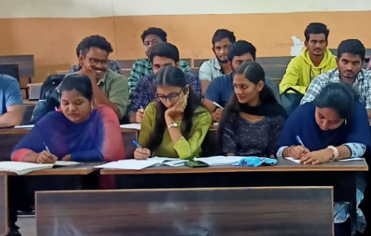
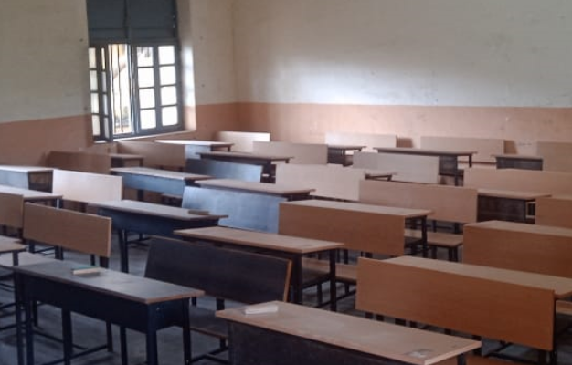
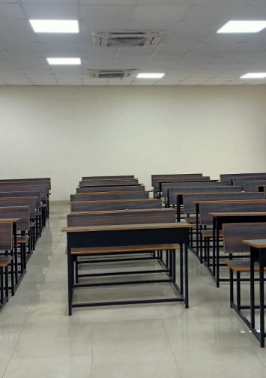
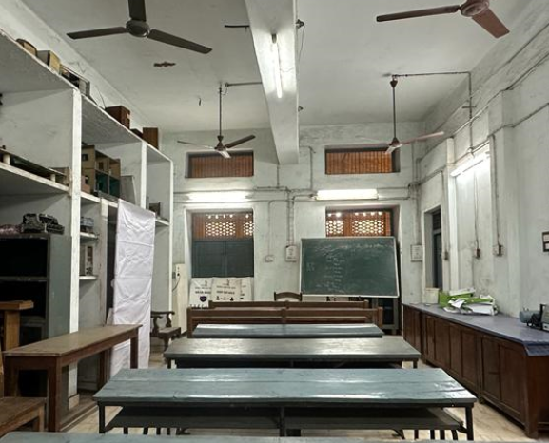
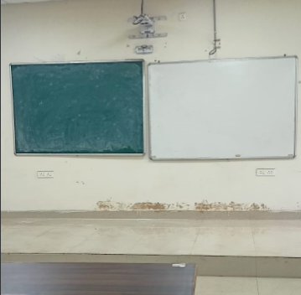
Criterion 4 Infrastructure and teaching resources
oClass rooms / smart class rooms
E Class Room - 205, Principal Block, AUCE
* The Department is totally technology enabled. There is 24*7 internet and Wi-Fi connection available for the staff and students. There is one LCD projector, 1 Digital interactive smart Board,

Slide 58

Criterion 4 Infrastructures and teaching resource
Department library/e -resources/Wi-fi/internet facilities/Bandwidth/link to library e resources
  College is having 1GBPS leased line.
  IEEE and DELNET, Central Funding (E-SHODHSINDHU, SHODHGANGA), J-GATE, INFILIBNET.
    https://www.andhrauniversity.edu.in/library
    E-Journals – IEEE, ASME etc.
    Apex Journals
    DELNET - http://delnet.in/
    J-Gate
    INFLIBNET

Slide 59

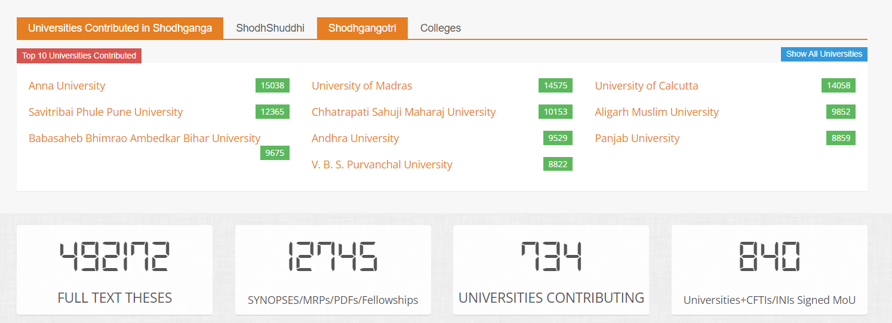
Infrastructures and teaching resource
Criteria 4
Link to library e resources (Contin..)
  SHODHGANGA - https://shodhganga.inflibnet.ac.in/
  Andhra University in Top 10 Indian Universities in Shodhganga.
Andhra University - 9529 Theses

Slide 60


Criterion 5
Students Support and Progression
Scholarships
S. No | Academic Year | Number of Students benefited | Amount (Lakhs)
1 | 2021-22 | 17 | 10.54
2 | 2022-23 | 9 | 5.58
Ragging Free Campus
Skill Development Programmes
Environment and Pollution Control Facilities Operator Skills
Environmental Instrumentation Analysis
Safety, Health and Environment
Air Quality Monitoring
Computer Applications in Environmental Engineering
Python Program
Python Lab
Internships
Soft Skils
English Language Lab
Ethics
NCC/NSS

Slide 61

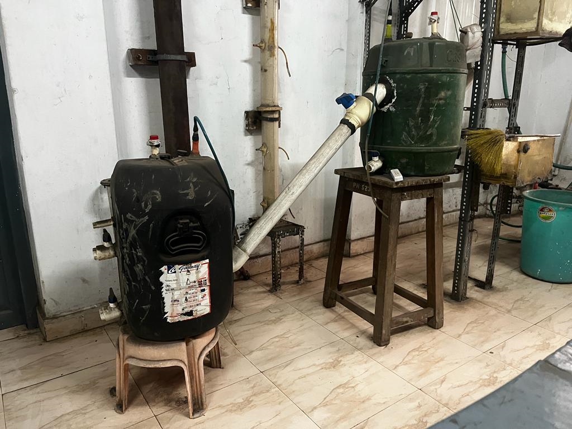
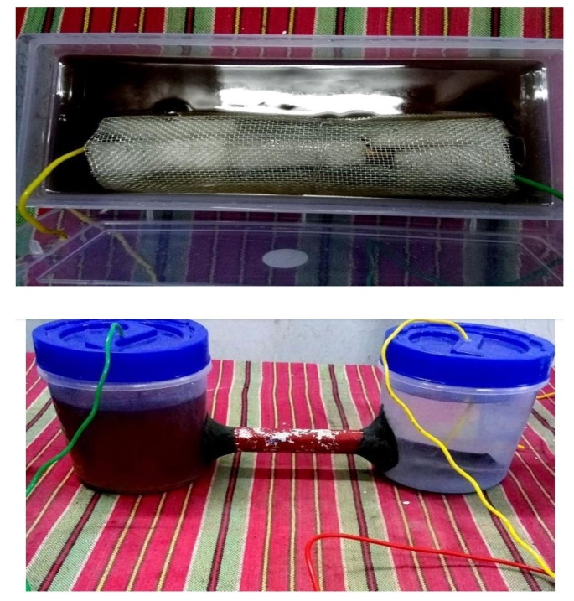
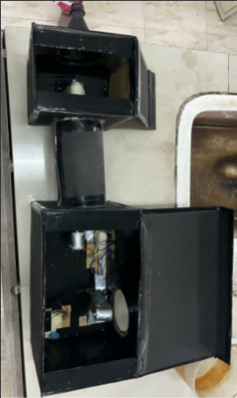
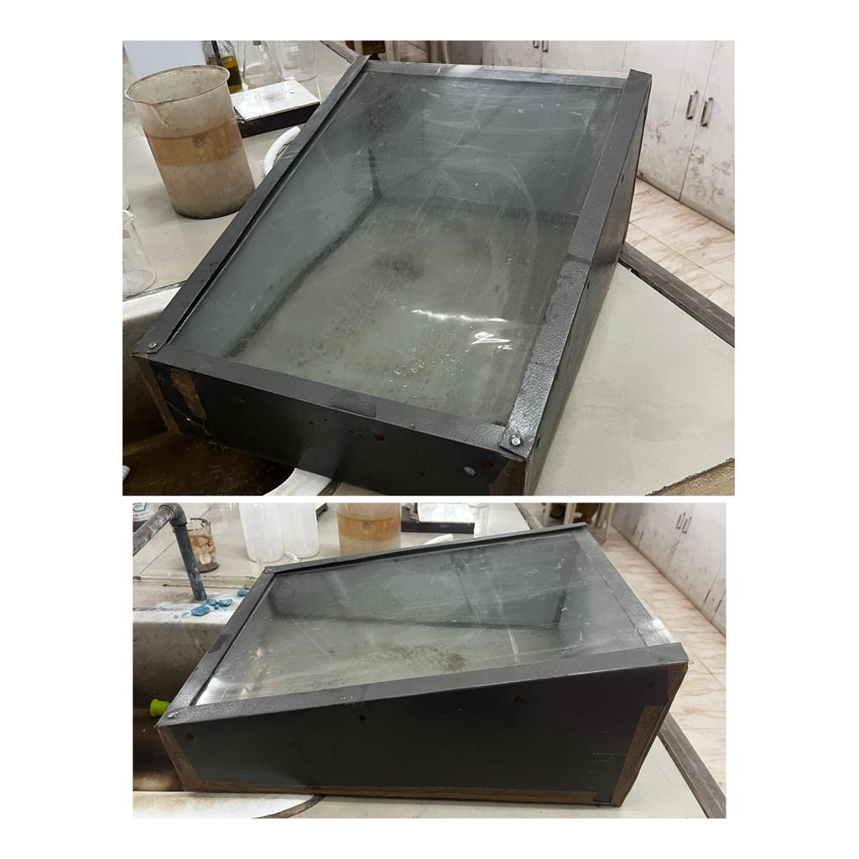
Laboratory Models Developed
Criterion 5
Digester
MFC
Indoor Air Pollution Equipment
Solar Panels
The above Shown Models are prepared as B.Tech Projects
Department of Environmental Science, Engineering & Management

Slide 62
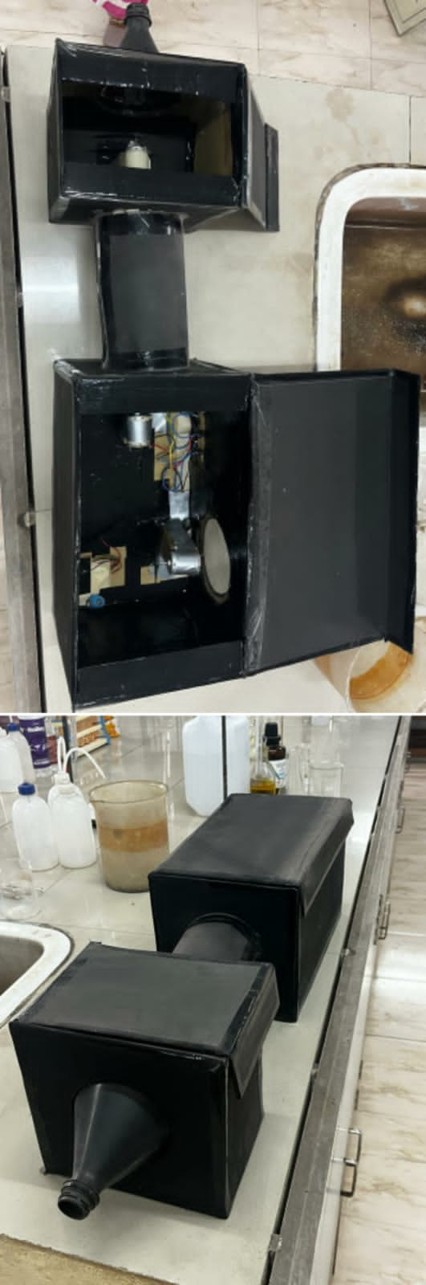
Solar Still & Indoor Air Pollution Equipment made as part of B.Tech project

Slide 63
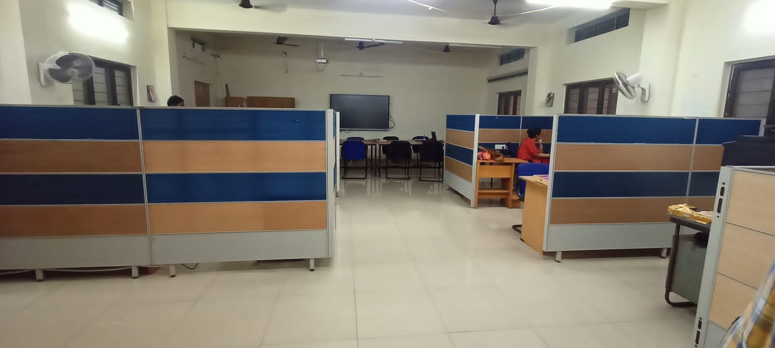
Cubicles built using discarded material as part of RRR project

Slide 64
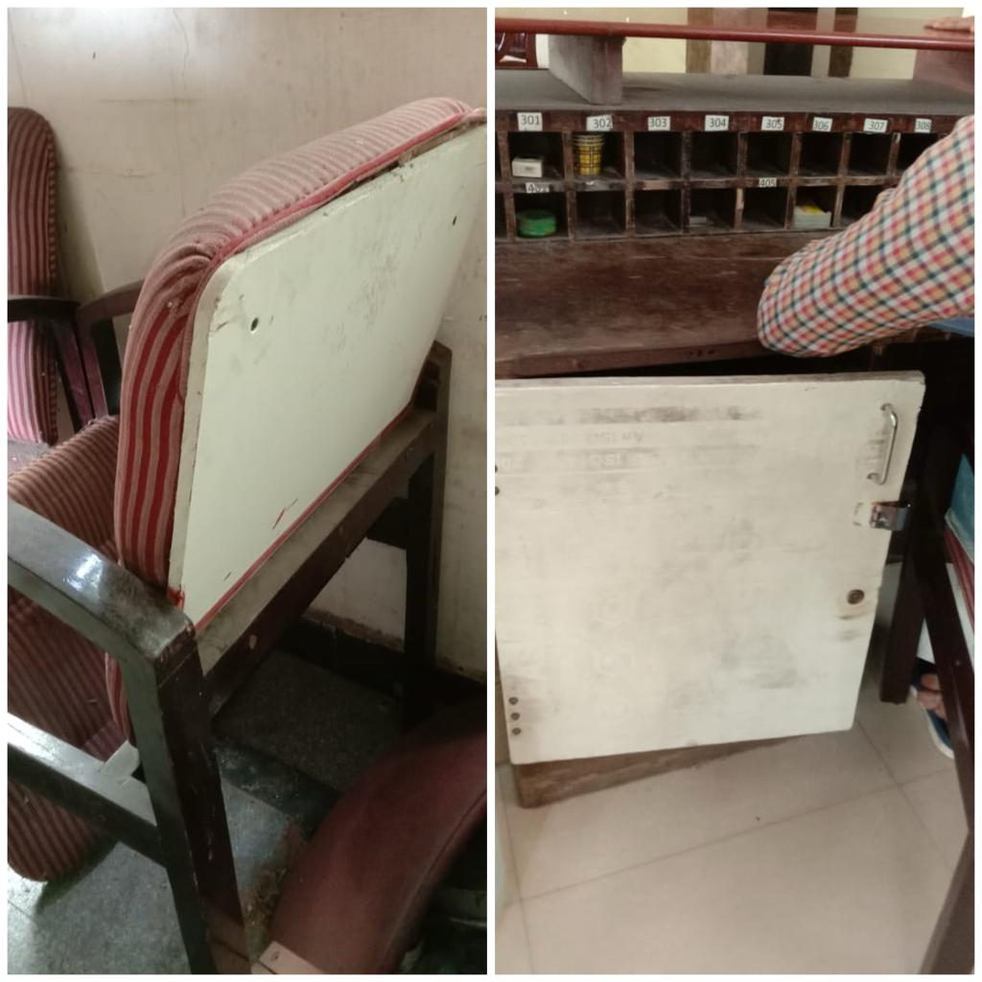
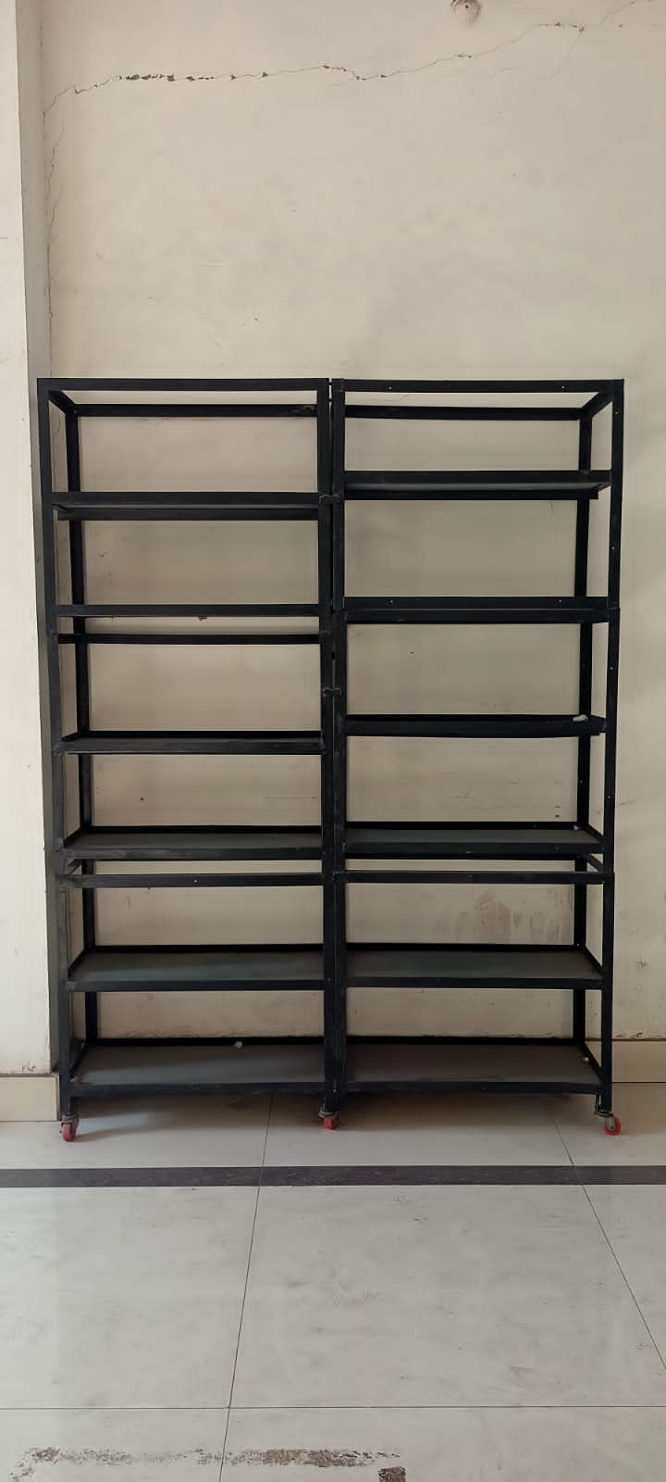
Discarded materials reused as back rail supporter of chair
and cabinet door
Bag (and/or) book rail made from waste battery trollies placed in Civil Department.

Slide 65
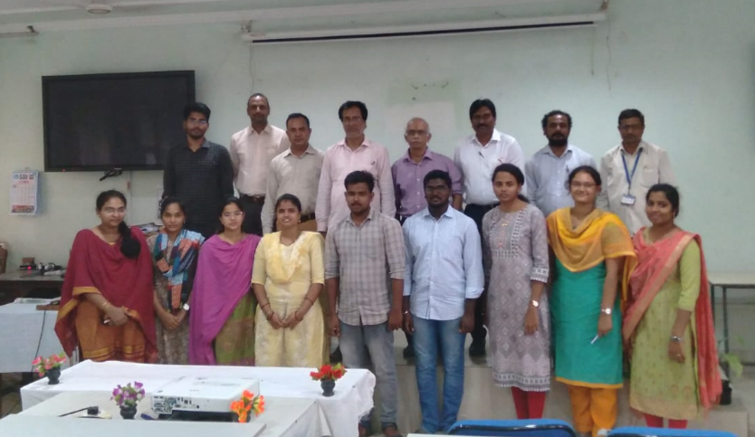
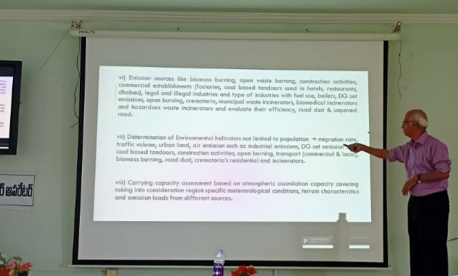
Infrastructure, Students Support and Progression
Criterion 5
FDP Program
Workshop
Department of Environmental Science, Engineering & Management

Slide 66
Criterion 6
Governance, Leadership/Management
Conferences /workshop attended
Year | Name of the teacher / Students | Name of conference/ workshop attended | Financial support provided (In INR)
2023-24 | Prof. S. Bala Prasad | Regional (South) meet of Institutes of Repute associated with NCAP: Convergence of Knowledge, Institutional Capacity and Infrastructure Building | ₹ 16,921/-
2023-24 | G.Ttharun I.T.Sahithi | CSIR – IITR “Environmental Pollution Predictions and Apportionment of Sources using Computational Modeling Techniques” Lucknow 2023 | ₹ 6,000/-
2022-23 | Prof. S. Bala Prasad | CSIR – IITR “Air Pollution Prediction and Apportionment of Sources using Computational Modelling Techniques” Lucknow 2022 | ₹ 2,000/-
Department of Environmental Science, Engineering & Management

Slide 67

Criterion 6
Governance, Leadership/Management (contd.,)
FDPs attended
S. No. | Name of the teacher/Students | Title of the program
1 | Prof. S. Bala Prasad | CSIR – IITR “Air Pollution Prediction and Apportionment of Sources using Computational Modelling Techniques” Lucknow 2022
2 | G.Ttharun I.T.Sahithi | CSIR – IITR “Environmental Pollution Predictions and Apportionment of Sources using Computational Modeling Techniques” Lucknow 2023
Department of Environmental Science, Engineering & Management

Slide 68



BEST PRACTICES
Industrial involvement in curricular development
Development
of environmental models during laboratory work.
Financial support to the students to carry out project studies.
Involvement of students in developing live projects.
Encouraging students towards start up and interaction with A-Hub.
Weekend internship program from 3rd year 1st semester onwards.
Continuous Institute-Institution, Institute- Industry, Institute-regulation interaction by the faculty.

Slide 69








Progressive Plan
Reseaích Píoposals, Peer Review Publications (SCI, Q1,etc), Books Publications &
Patent Commeícialization,
Multi-Disciplenaíy Reseaích
Research Culture
Professional Trainings, Alumni Talks, Internships
Employability Skills
Doing Ph.D. & Projects relating to industry and Society problems
HR ľíainings, Seminaís, Skill Development Píogíammes , Student Exchange Píogíammes
Social Responsibilty
Personal Development
Innovative ľeaching Methods,
Online couíses, Industíial Visits, ľechnical Seminaís, Minoí & Honoíaíy
Degíees
Technical Skills

Slide 70
THANK YOU

